Slide 1

Pricing Adjustment for Big Mountain Resort
Keshav Mantha

Slide 2
The Facts
New Chair Lift Installed
$1,540,000 increase in operating costs
$81 Current Ticket Price
Most premium resort in Montana
350k Visitors Expected
Ski ~5 days on average

Slide 3
The Problem
New ski lift increases operation costs by $1,540,000
Currently charge $81 for tickets
Expecting 350k visitors
Can we either increase ticket prices, or cut down operating costs?
If we can increase prices, then by how much?
Can we make operational readjustments?

Slide 4
Recommendations
Increase ticket price from $81 to anywhere from $84 to $95 (approx.)
Minimum increase can be $2.83
Can go up by (up-to) $8.61 or $9.90
Price increase may be contingent on removal of some features and addition of others
Close the most unused run
Add a new run, increase the vertical drop by 150 feet, install an additional lift ($8.61)
In addition, add 2 more acres of snowmaking area ($9.90)

Slide 5
Data Analysis
To create a model, comparable resorts were chosen based scaled pricing in conjunction with statewide population and acreage data
For example, New York had more resorts with greater price range possibly due to population density of the state, but its resorts missed many features Big Mountain has
8 features were cross-validated to measure performance
Within those features, the top 4 were: number of chairs, total runs, snow-making area, and vertical drop
Using random forest regression proved to have the highest predictability
Big Mountain compared strongly both nationally and locally on the top 4 features

Slide 6
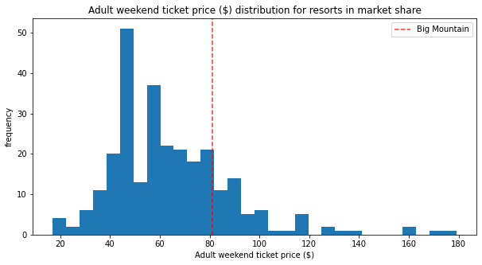
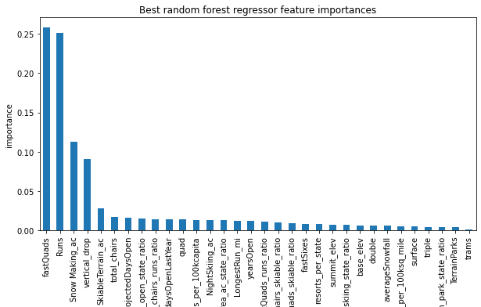
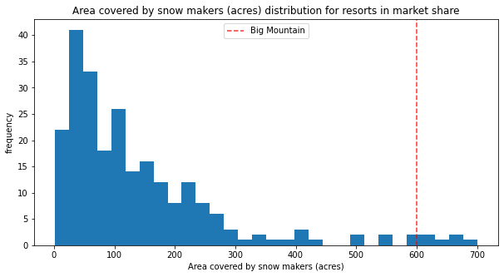
Data Analysis

Slide 7
Analysis Conclusions
Initial results predicted a ticket price of $94.22, which is much higher than the current ticket prices, and this considers that it’s already the most expensive in Montana.
However, considering where Big Mountain stands in terms of the four most important features associated with price, this higher price makes sense.
Subtracting the mean absolute error from that predicted price leads to a rough estimate of a minimum increase, which could be as small as $2.83.
If the resort is projected to have 350,000 visitors a year, and each of those visitors buys the average of 5 days of skiing, that would lead to increased revenue of $4,952,500, implying $3,412,500 of total revenue when the new lift costs are accounted for.
Final profit margin is unknown since we do not know total annual revenue.

Slide 8

Summary
Big Mountain certainly has room to increase ticket price.
This amount is primarily dependent on how many chairs the resort can offer, how many of those chairs are fast quads, and the amount of snow-making acreage.
At minimum, the tickets can increase in price by $2.83, but there is room for those tickets to increase up to $94.22

